Slide 1
Spartan Empire

Slide 2
Sparta
Aprox. 950 BC to 300 BC
Founded by Dorians
Invaded city of Peloponnesus
Population growth = territory expansion
Helots (HEH – luhts) meaning “capture”

Slide 3
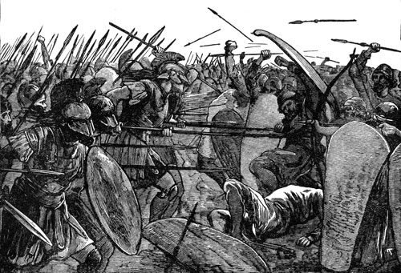
Spartan Military
Boys training 7 to 20
join regular army at 30
temporary leave at 30 to start a family
Remain in barracks from 30 to 60
Remain in army until age 60
Soldiers expected to win or die, never surrender
Army made of 10,000 men

Slide 4
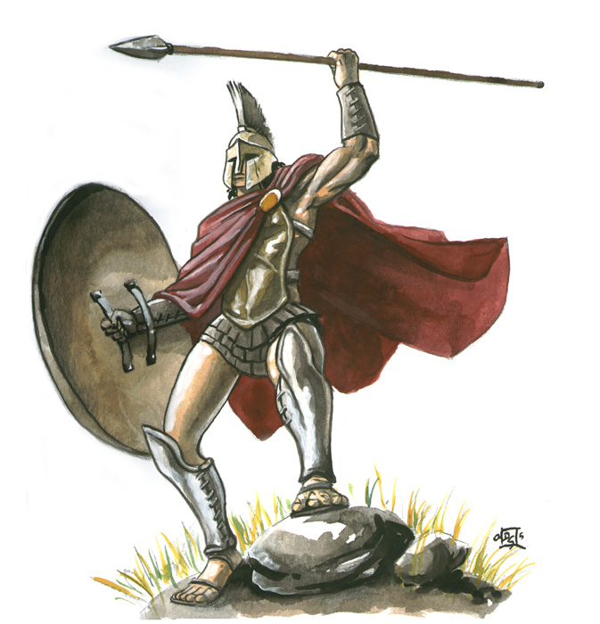
Ideal Warrior
Each warrior carried
Spear
Sword
Shield
Bronze armor
Helmet
http://www.history.com/videos/spartans-deconstructed#spartans-deconstructed

Slide 5
Athletics
Female passtime
Trained in sports
- running
-wrestling
-throwing javelin
Purpose: keep fit to become healthy mothers

Slide 6
Women’s Rights
Could own property
Free to go where they pleased without male escort
But had no political power

Slide 7
Home Life
Wives lived at home
ran household
raised children
Husbands lived in barracks
Military
Gone fighting wars

Slide 8
Government
Oligarchy (Ah-luh-GAHR-kee) a few hold power
2 kings headed council of elders
Council made of 28 male citizens over 60
Assembly- all Spartan men over 30
Assembly voted on councils laws and chose 5 ephors
Ephor (EH-fuhrs) enforced laws and manged tax collection

Slide 9
Restrictions
Discouraged foreign visitors
Banned travel (except military travels)
Frowned upon citizens who studied literature and the arts
http://www.history.com/videos/spartans#spartans

