Slide 1
Team 10
High-Involvement Work Systems
Stephen Barta, Shelby Thomas

Slide 2
Does Anyone ‘think’ their company uses a High Performance or High Involvement Work System?

Slide 3
FROM EMPLOYEE-EXPERIENCED HIGH-INVOLVEMENT WORK SYSTEM TO INNOVATION: AN EMERGENCE-BASED HUMAN RESOURCE MANAGEMENT FRAMEWORK
Yixuan Li, Mo Wang, Danielle D. Van Jaarsveld, Gwendolyn K. Lee, Dennis G. Ma
Presented by Stephen Barta

Slide 4
Key Terms
HIWS: High Involvement Work Systems:
“Practices for generating high involvement and high performance among employees”

Slide 5
Hypothesis
“...an employee-experienced high-involvement work system (HIWS) promotes innovation by eliciting collective interactions for knowledge exchange and aggregation.”

Slide 6
Sample
Data extracted from Workplace and Employee Survey (WES) data collected by Statistics Canada (Statistics Canada, 2009)
Final sample consisted of 2,639 workplaces and 12,519 employees.
The mean workplace size was approximately 49 employees
(SD = 100.09)
average length that workplaces had been located at their current address was 19.32 years (SD = 17.56).

Slide 7
Results
HIWS was positively and significantly related to innovation,
b = 1.55, p < 0.01.
The strategic importance of innovation was positively and significantly related to innovation,
b = 0.20, p < 0.01
Churn in human resources was also positively and significantly related to innovation
b = 0.06, p <0.01.

Slide 8
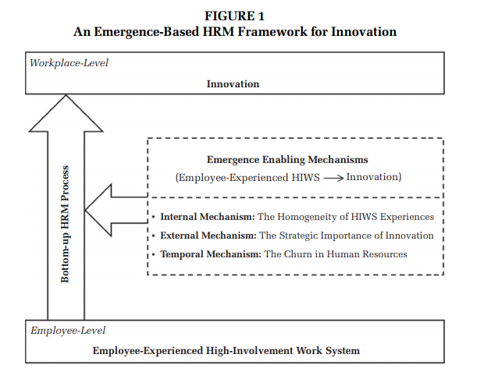

Slide 9
Important Considerations
Uniformity of HIWS Experiences
The Strategic Importance of Innovation
Churn in Human Resources

Slide 10
Important Considerations
Ensure that all employees get the same experience.
Make innovation important to the company strategy and let your workers know of its importance.
Focus on external hiring.

Slide 11
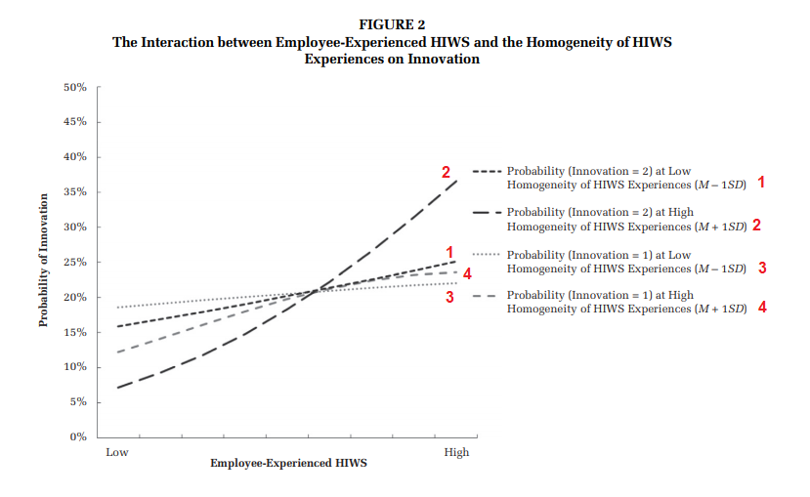

Slide 12
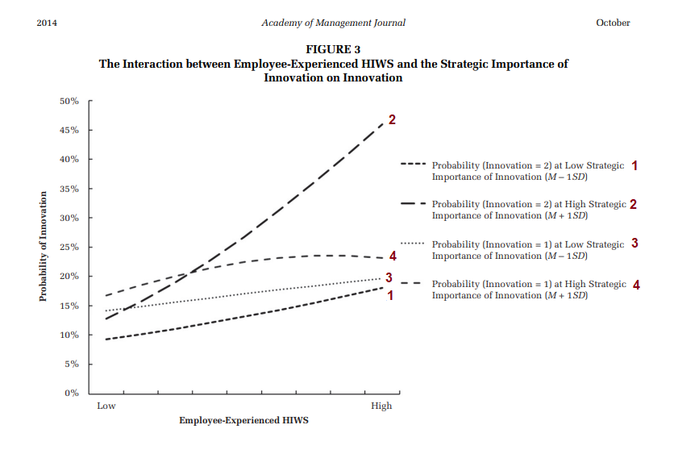

Slide 13
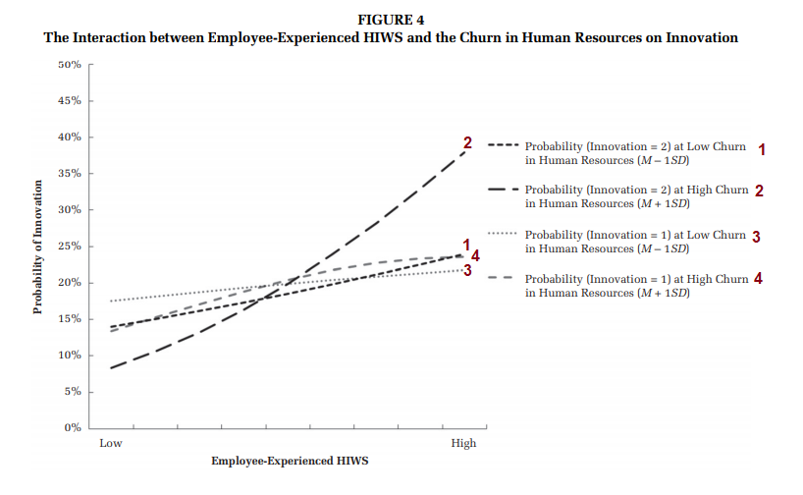

Slide 14
This does not work for every type of company!

Slide 15
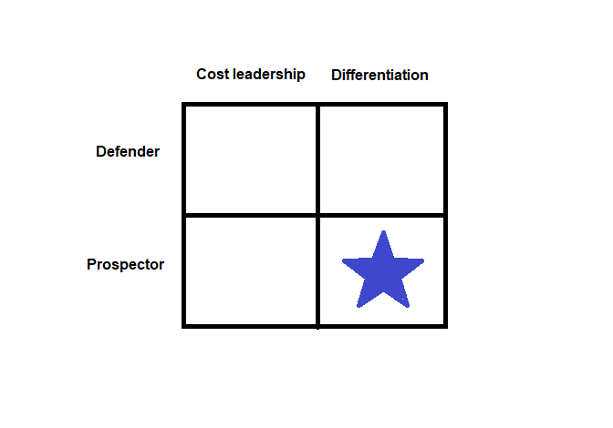

Slide 16
HOW DO HIGH INVOLVEMENT WORK PROCESSES INFLUENCE EMPLOYEE OUTCOMES? AN EXAMINATION OF THE MEDIATING ROLES OF SKILL UTILISATION AND INTRINSIC MOTIVATION
Peter Boxall, Ann Hutchison and Brigitta Wassenaar
Presented by Shelby Thomas

Slide 17
Key Terms
Cognitive Path: high-involvement processes take greater advantage of the skills and abilities their employees already have.
Tayloristic Job Design: evaluating every step in a manufacturing process and breaking down production into specialized repetitive tasks
Counter-Balancing: controlling order effects in repeated measure designs.

Slide 18
Hypothesis
H1. Worker perceptions of higher levels of power, information, reward, and knowledge will predict greater job satisfaction
H2. Worker perceptions of higher levels of power, information, reward and knowledge will predict higher levels of affective commitment
H3. Worker perceptions of higher levels of power, information, reward and knowledge will predict lower stress
H4. Skill utilisation will mediate the relationships between the independent variables of power, information, reward, knowledge, and the dependent variables of job satisfaction (higher), affective commitment (higher), and stress (lower)
H5. Intrinsic motivation will mediate the relationships between the independent variables of power, information, reward, knowledge, and the dependent variables of job satisfaction (higher) and affective commitment (higher)

Slide 19
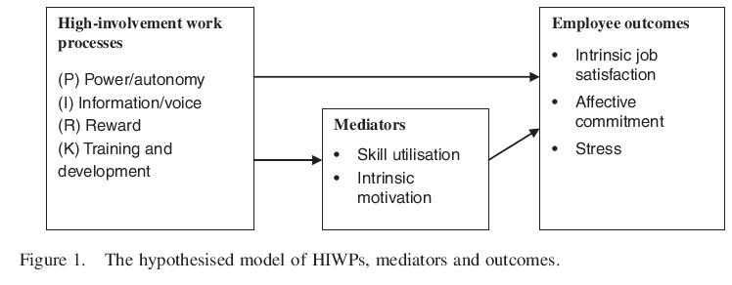
Mediating Links Between Involvement and Employee Outcomes

Slide 20
The Study
To study the relationships between involvement processes, the mediating variables, and employee outcomes
The organization is trying to enhance worker involvement in problem-solving and by making investments in training.
GOAL: Ameliorate Taylorist job design through greater employee participation in management.
Team Briefings, Opportunity for involvement, Service Improvement Strategies

Slide 21
Measurements
Dependent Variables
PIRK Variable
Intrinsic Job Satisfaction: 1-5 Likert Scale
Employee Affective Commitment: Strongly Agree to Strongly Disagree Likert Scale
Employee Stress: One -Item Measure Rated on a Scale of 1-10
Skill Utilisation: 6-Item Measure
Intrinsic Motivation: 5-Point Likert Scale
Power
Information
Reward
Knowledge
Likert Scale of Strongly Agree to Strongly Disagree

Slide 22
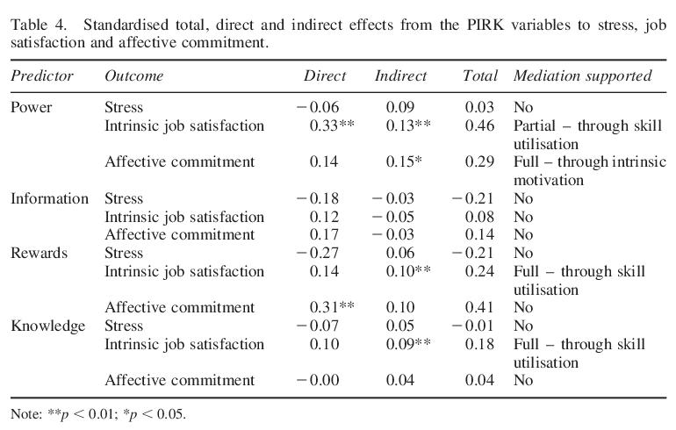
Results
H1: Confirmed ¾ independent variables (PIRK)
H2: Supported for ½ of the independent variables
H3: Not supported.
H4 & H5: Mediating effects

Slide 23
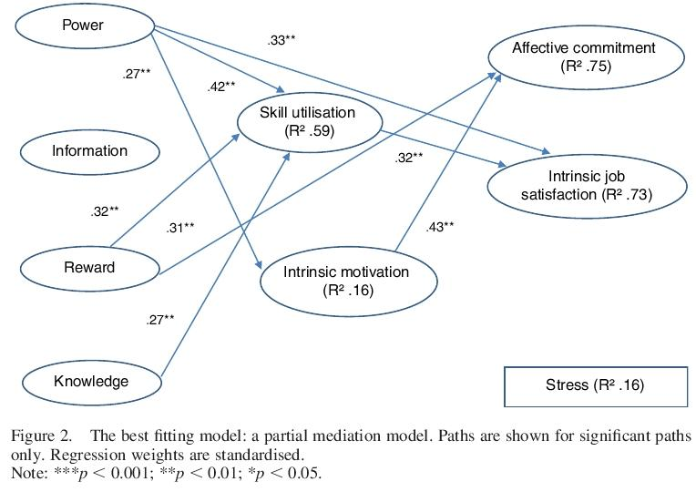

Slide 24
Takeaway
Workers having greater discretion in a job and greater opportunities for participation in relevant decisions opens up opportunities to use their skills and enhances intrinsic satisfaction.
This study does not claim a net benefit for employers from HIWP but a demonstration of how workers benefit.
Creating scope for worker control is essential in reversing under-utilisation of skills.

Slide 25
Questions or Comments?

