Slide 1
Training and Development
On Yi (Phoebe) Kwok Arunima Gupta

Slide 2
Women’s Managerial Aspirations: An Organizational Development Perspective Jenny M Hoobler Grace Lemmon Sandy J Wayne , The Journal of Management
Glass Ceiling
Social Role Theory

Slide 3
Hypothesis
Hypothesis 1: Managers will perceive female (vs. male) subordinates as lower in career motivation.
Hypothesis 2: Subordinates’ receipt of (a) challenging work assignments, (b) training and development, and (c) manager career encouragement will be positively related to their managerial aspirations.
Hypothesis 3: Managers’ perceptions of their subordinates’ career motivation will mediate the relationship between sex and subordinate reports of receipt of (a) challenging work, (b) training and development, and (c) manager career encouragement.

Slide 4
Method
Employees from midwest Fortune 500 company
Sampling of 52 Managers and 112 Subordinates answered a survey
Both were asked questions regarding each other

Slide 5
Measures/ Control Variables
Managers surveying Subordinates:
Education , performance, number of promotions ect.
Subordinates surveying Managers
Challenging work, career encouragement, training and development , children ect.

Slide 6
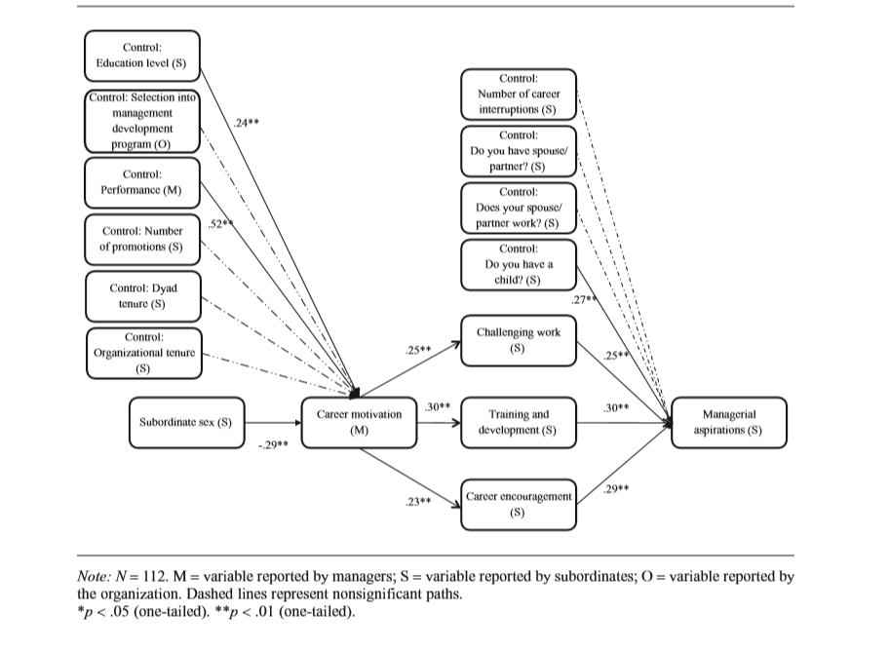
Results

Slide 7
Takeaway
Managers must make sure they don’t enforce the stereotype that women are less career motivated than men because this initial assumption is what can hinder managerial aspirations in women

Slide 8
Recommendations
-Open conversation with managers
-mentoring opportunities

Slide 9
Does the gender of an executive officer affect the level of representation of women in management?

Slide 10
The Glass Ceiling in Context: the Influence of CEO Gender, Recruitment Practices and Firm Internationalisation on the Representation of Women in Management, Eddy S. Ng, and Greg J. Sears, The Journal of Management
Glass Ceiling
Internationalisation

Slide 11
Hypothesis
Hypothesis 1: The presence of a female CEO will be associated with a greater percentage of women in management
Hypothesis 2: The extent to which an organization is actively recruiting women will be associated with a greater percentage of women in management
Hypothesis 3: The extent to which an organization is dependent on international operations will be associated with a lower percentage of women in management
Hypothesis 4: Foreign ownership of firms will be associated with a lower percentage of women in management in the firm’s host country operations

Slide 12
Methods
Survey questionnaire for CEOs and Senior HR executives
278 Companies
Second mailing and follow-up telephones calls
Financial Post 500 largest companies

Slide 13
Measurement
Control Variables
Organization size
Presence of unions
Outcome Variables
Total number of both men and women in management
Excluding senior managers

Slide 14
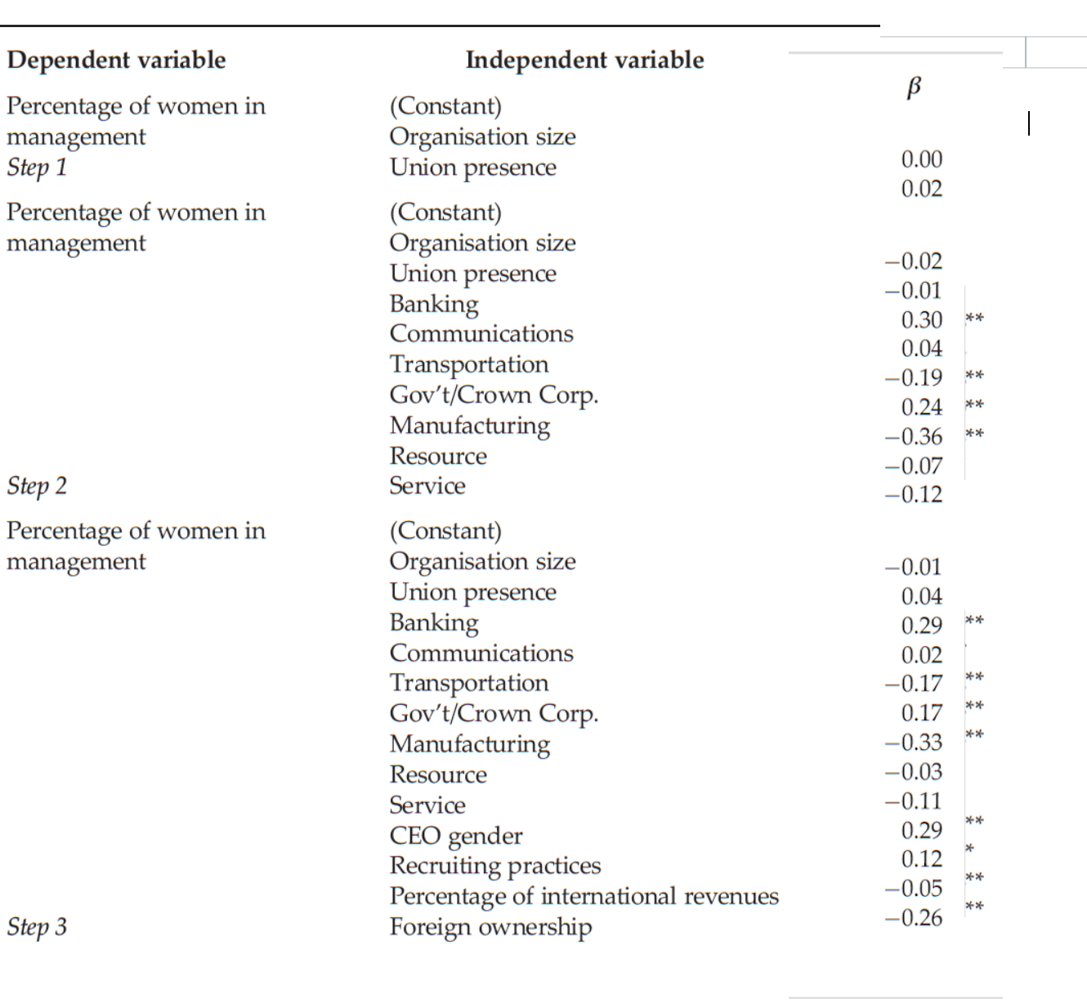
Results

Slide 15
Takeaway
Women could have comparable qualifications as their male colleagues, yet women would bump into a glass ceiling advancement opportunity arises. Overtime, more women can be seen in executive positions. In the meantime, the most effective would be through the active recruitment of women.

Slide 16
Recommendations /Group Takeaway
Lead and Learn Experience
Mentoring Programs
Internally Recruiting

Slide 17
Thank You
Questions, Comments?

