Slide 1
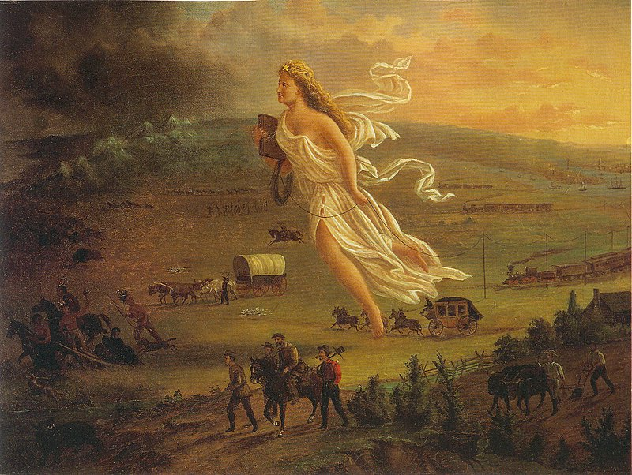
“…From Sea to Shining Sea”
Westward Expansion
Of
the United States
John Gast, American Progress, 1872

Slide 2
ESSENTIAL QUESTION
How does the term “Manifest Destiny” capture the essence of the Westward Expansion of the United States during the 19th century?

Slide 3
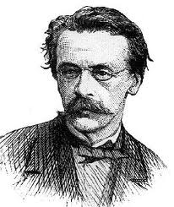
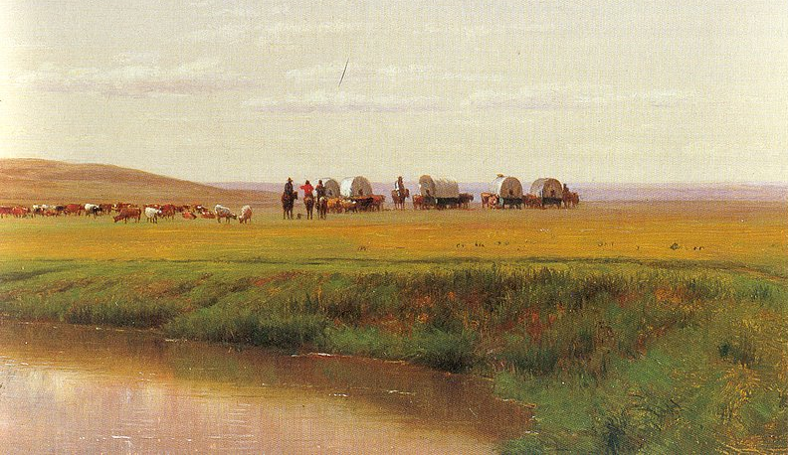
John O’Sullivan
Democratic Review
1830’s-40’s
MANIFEST DESTINY
Worthington Whittredge, Wagon Train in the Plains, Platte River, Colorado, (The Pope Expedition), 1866

Slide 4
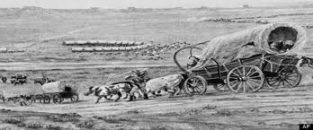
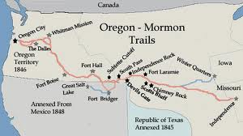
Document Study:
John L. O'Sullivan on Manifest Destiny, 1839
Excerpted from "The Great Nation of Futurity," The United States Democratic Review, Volume 6, Issue 23, pp. 426-430
https://www.mtholyoke.edu/acad/intrel/osulliva.htm

Slide 5
Common Core Reading & Writing Lesson
Reading Standard for Literacy
#4 Determine the meaning of words and phrases as they are used in a text, including analyzing how an author uses and refines the meaning of a key term over the course of a text
Writing Standard for Literacy
#1c Use words, phrases, and clauses to link major sections of text and clarify the relationship between claims, reasons, and evidence

Slide 6
YOUR TASK (Formative Assessment):
To write a paragraph in your own words that defines “Manifest Destiny” (O’Sullivan’s “claim”) and cites specific reasons and evidence from the text that explains why O’Sullivan believed we were so “destined” for this greatness.
OUR PROCESS:
Share read document focusing on Academic Language (Tier 2 & 3 terms)
Summarize main ideas in 4 excerpts & put these in your own words
Combine summary sentences into a paragraph

Slide 7
Basic Assumptions: Manifest Destiny
Americans were building a new civilization in the 19th C, whereas European nations were falling apart
Americans were granting individual rights to all peoples in the newly acquired territories

Slide 8
Democracy in the Western Hemisphere was a “palatable antidote” to the archaic monarchy in the Old World
American pioneers had a “moral idealism” that would seed the new territories

Slide 9
Divine Providence, through some selection process, wished to entrust the future of humanity to the leadership of the new “city on the hill”
Americans had every justification for opposing or dominating any race or culture that chose not to share these positions

Slide 10
Louisiana Purchase
Get crops to market! --Jefferson

Slide 11
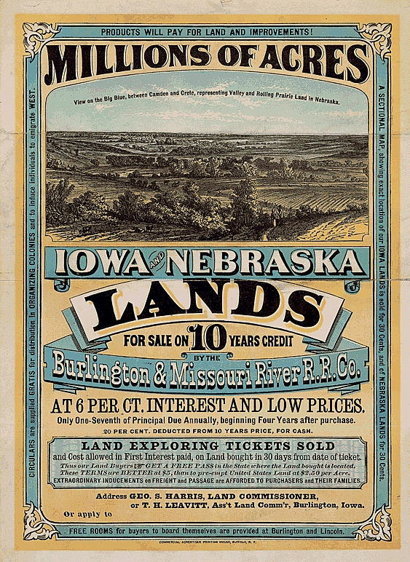
Why Go West?
Desire for Adventure
Fertile & Cheap Land
New Markets

Slide 12
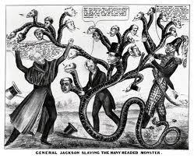
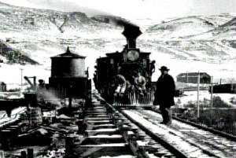
Access to Trade with China
Panic of 1837
Improved Transportation

Slide 13
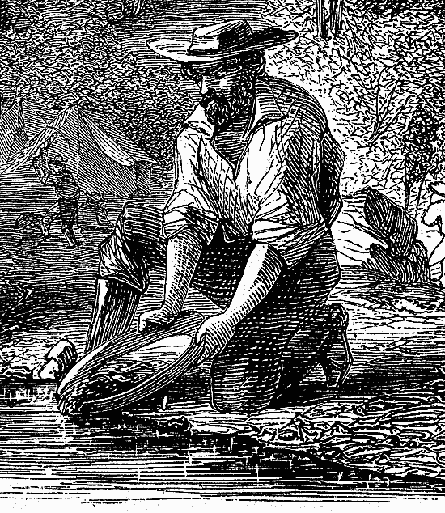
New Immigrants
8. Moralistic & Religious Reasons
Gold Rush
Desire to Spread the
Virtues of Democracy

Slide 14
Frederick Jackson Turner Frontier Thesis
"The frontier is the line of most rapid Americanization."
“…that coarseness and strength combined with acuteness and acquisitiveness; that practical inventive turn of mind, quick to find expedients; that masterful grasp of material things... that restless, nervous energy; that dominant individualism" -- could all be attributed to the influence of the frontier.

Slide 15
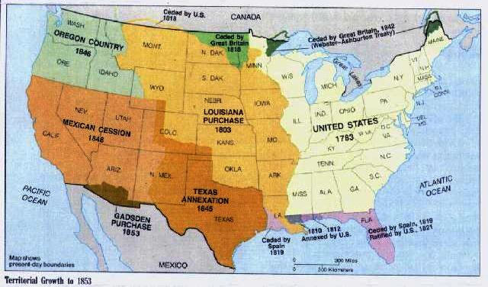

Slide 16
Frederick Jackson Turner’s
The Frontier was the chief influence in shaping American life:
Social equality
Growth of political democracy
Nationalism
Faith in the future
Economic independence
Safety valve for factory workers
Invention
Individualism
“FRONTIER THESIS”
1893

Slide 17
Critics of the Frontier Thesis
Ignored the Indians
Can the West apply to all?
Cooperation & communities
Role of the Federal government & large corporations
No freedom & opportunity for some

Slide 19
Westward Expansion D.B.Q.
Work in non-grade level groups of 3
Read the Essay question & all 8 documents
For each document, create 2 questions:
1 literal & 1 interpretive
Create an Answer Key for Scaffolding Q’s
Create a list of Relevant Outside Information
(10-12 items)

Slide 20
Westward Expansion D.B.Q.
Change Essential Question to:
“Was the Fed Gov’t justified in the actions it took to promote Westward Expansion?”
1. Skim docs & scaffolding Q. to refresh memory for content
2. Read last 2 pages: “Key Ideas from Docs” & “”Relevant Outside Info”; Place a checkmark next to the info you know enough about to use if you were to write this essay.

Slide 21
3. Review Thesis Paragraph checklist & be ready to
write a Thesis Paragraph (6-8 sentences)
4. Ask a clarifying question or restate the task
Write the first draft of your Thesis Paragraph
(Take 15 minutes)
Pair/Share Thesis paragraph drafts, using the checklist; provide feedback
Homework: Type up revised Thesis Paragraph & bring it to next class

Slide 23
Frances Palmer, Across the Continent: “Westward the Course of Empire Takes Its Way,” lithograph, 1868, Currier & Ives

Slide 24
Miller, Surround of Buffalo by Indians, ca 1848-58

Slide 25
Alfred Jacob Miller, The Lost Greenhorn, n.d

Slide 26
Stanley, John Mix, Herd of Bison near Jesse, 1853
(lithograph in Pacific Railroad Survey reports)

Slide 27
William Jacob Hays,
A Herd of Bison Crossing
the Missouri River, 1863

Slide 30
Cherokee Nation v. Georgia 1831
Issue: Whether the state of Georgia could enforce its state laws upon the Cherokee Nation and deny the constitutional jurisdiction of the Supreme Court
Opinion: The Supreme Court denied the Cherokees’ request, reasoning it had no jurisdiction to decide such a case. Chief Justice John Marshall wrote, “this is not the tribunal that can redress the past or prevent the future.”

Slide 31
Worchester v. Georgia 1832
Issue: Whether States had the reserve power to pass laws concerning the Indian nations
Opinion: The Court ruled that the State had no power to pass any laws affecting the Cherokees because federal jurisdiction over the Cherokees was exclusive.
Jackson stated that Chief Justice Marshall had made his decision; now let him enforce it!
Led to the “Trail of Tears”

Slide 32
Trail of Tears 1838-39

Slide 33
Constitutional Questions
Separation of Powers
(Checks & Balances)
---------------------
Federalism

Slide 37
Battle of Wabash River
Little Turtle
St. Clair defeated

Slide 38
“This immence river so far as we have yet ascended, waters one of the fairest portions of the globe, not do I believe that there is in the universe a similar extent of country, equally fertile, well watered, and intersected by such a number of navigable streams” Lewis to his mother, from Fort Mandan, March 31, 1805

Slide 39
War of 1812 (Battle of New Orleans 1815)

